Slide 1

Berkenalan dengan Front end Web Developer

Slide 2




Muhammad Febrian
Staff of Website Developer - Front end
1+ tahun pengalaman
blogrian.my.id
instagram.com/udahtahubelum_
@riann18 mfebriann#3886
mfebrian22

Slide 3
Front end Web Development?

Slide 4
“Front end Web Development adalah pengembangan antarmuka pengguna grafis dari sebuah situs web, melalui penggunaan HTML, CSS, dan Javascript, sehingga pengguna dapat melihat dan berinteraksi dengan situs website tersebut.”
https://en.wikipedia.org/wiki/Front-end_web_development

Slide 5
Front end Web Developer?

Slide 6
“Semua yang Kamu lihat pada sebuah website, seperti tombol, link, animasi, dan banyak lagi, diciptakan oleh Front end web developer.”
https://www.freecodecamp.org/news/front-end-developer-what-is-front-end-development-explained-in-plain-english/

Slide 7
“Front end developer adalah pengembang website yang menggunakan baris kode HTML, CSS, dan JavaScript untuk menghasilkan website dengan tampilan yang menarik. Mereka adalah orang-orang yang mengolah desain murni menjadi website yang interaktif dengan pengguna.”
https://www.niagahoster.co.id/blog/skill-front-end-developer/

Slide 8
Roadmap Front end Web Developer?

Slide 9
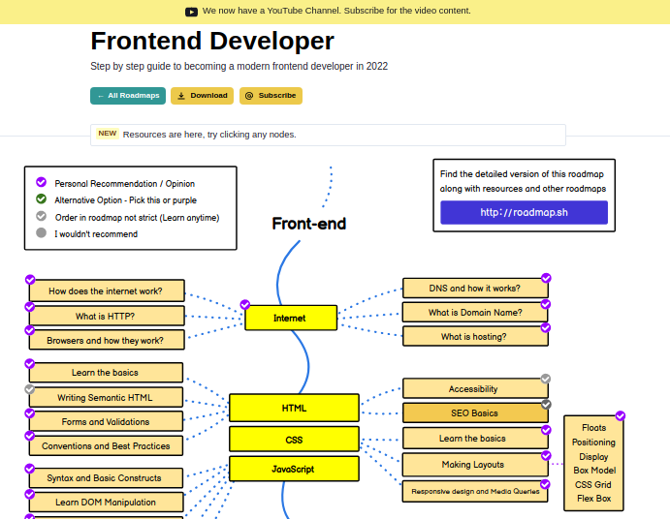
https://roadmap.sh/frontend

Slide 10
Sabar dulu :)

Slide 11



HTML
CSS
Javascript

Slide 12
HTML

Slide 13
HTML
Basic HTML

Slide 14
HTML
Basic HTML
Semantic Elements

Slide 15
HTML
Basic HTML
Semantic Elements
Form Validations

Slide 16
HTML
Basic HTML
Semantic Elements
Form Validations
SVG & Canvas

Slide 17
HTML
Basic HTML
Semantic Elements
Form Validations
SVG & Canvas
Information Architecture

Slide 18
HTML
Basic HTML
Semantic Elements
Form Validations
SVG & Canvas
Information Architecture
Accessibility

Slide 19
HTML
Basic HTML
Semantic Elements
Form Validations
SVG & Canvas
Information Architecture
Accessibility
SEO (Search Engine Optimization)

Slide 20
CSS

Slide 21
CSS
Basic CSS

Slide 22
CSS
Basic CSS
CSS Layouting

Slide 23
CSS
Basic CSS
CSS Layouting
Filter, Transition & Animation

Slide 24
CSS
Basic CSS
CSS Layouting
Filter, Transition & Animation
Responsive Design

Slide 25
CSS
Basic CSS
CSS Layouting
Filter, Transition & Animation
Responsive Design
Modern CSS

Slide 26
CSS
Basic CSS
CSS Layouting
Filter, Transition & Animation
Responsive Design
Modern CSS
CSS Methodologies

Slide 27
Javascript

Slide 28
Javascript
Basic Concepts

Slide 29
Javascript
Basic Concepts
DOM (Document Object Model)

Slide 30
Javascript
Basic Concepts
DOM (Document Object Model)
Hoisting

Slide 31
Javascript
Basic Concepts
DOM (Document Object Model)
Hoisting
ES6

Slide 32
Javascript
Basic Concepts
DOM (Document Object Model)
Hoisting
ES6
Asynchronous

Slide 33
Javascript
Basic Concepts
DOM (Document Object Model)
Hoisting
ES6
Asynchronous
Fetch API

Slide 35
Buat Portfolio

Slide 36
Buat Portfolio
Project pribadi

Slide 37
Buat Portfolio
Project pribadi
Kontribusi project open source / Project komunitas

Slide 38
Buat Portfolio
Project pribadi
Kontribusi project open source / Project komunitas
Magang / Sukarelawan

Slide 40
Front end Web Developer lebih lanjut

Slide 41
Version Control System

Slide 42
Version Control System
Git

Slide 43
Version Control System
Git
SubVersion

Slide 44
Version Control System
Git
SubVersion
CVS (Concurrent Version System)

Slide 45
Version Control System
Git
SubVersion
CVS (Concurrent Version System)
Mercurial

Slide 46
Version Control System
Git
SubVersion
CVS (Concurrent Version System)
Mercurial
…

Slide 47
Version Control System
Git
SubVersion
CVS (Concurrent Version System)
Mercurial
…
Layanan Version Control System

Slide 48
Version Control System
Git
SubVersion
CVS (Concurrent Version System)
Mercurial
…
Layanan Version Control System
Github

Slide 49
Version Control System
Git
SubVersion
CVS (Concurrent Version System)
Mercurial
…
Layanan Version Control System
Github
Gitlab

Slide 50
CSS Preprocessor

Slide 51
CSS Preprocessor
SASS (Syntactically Awesome Style Sheets)

Slide 52
CSS Preprocessor
SASS (Syntactically Awesome Style Sheets)
LESS (Learner Style Sheets)

Slide 53
CSS Preprocessor
SASS (Syntactically Awesome Style Sheets)
LESS (Learner Style Sheets)
Stylus

Slide 54
CSS Preprocessor
SASS (Syntactically Awesome Style Sheets)
LESS (Learner Style Sheets)
Stylus
PostCSS
…

Slide 55
CSS Framework / Library

Slide 56
CSS Framework / Library
Bootstrap

Slide 57
CSS Framework / Library
Bootstrap
TailwindCSS

Slide 58
CSS Framework / Library
Bootstrap
TailwindCSS
Bulma

Slide 59
CSS Framework / Library
Bootstrap
TailwindCSS
Bulma
Material UI

Slide 60
CSS Framework / Library
Bootstrap
TailwindCSS
Bulma
Material UI
Chakra UI

Slide 61
CSS Framework / Library
Bootstrap
TailwindCSS
Bulma
Material UI
Chakra UI
…

Slide 62
Javascript Framework / Library

Slide 63
Javascript Framework / Library
React

Slide 64
Javascript Framework / Library
React
Vue

Slide 65
Javascript Framework / Library
React
Vue
Svelte

Slide 66
Javascript Framework / Library
React
Vue
Svelte
Angular

Slide 67
Javascript Framework / Library
React
Vue
Svelte
Angular
…

Slide 68
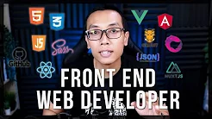
https://youtu.be/qzMPvbL3GRQ

Slide 70
Jadi kesimpulan nya adalah…

Slide 71
Perbedaan Front end Web Development & Front end Web Developer

Slide 72
Front end Web Development & Front end Web Developer itu sama
HTML

Slide 73
Front end Web Development & Front end Web Developer itu sama
HTML
CSS

Slide 74
Front end Web Development & Front end Web Developer itu sama
HTML
CSS
Javascript

Slide 75
Front end Web Development & Front end Web Developer itu sama
HTML
CSS
Javascript
Version Control System

Slide 76
Front end Web Development & Front end Web Developer itu sama
HTML
CSS
Javascript
Version Control System
CSS Preprocessor

Slide 77
Front end Web Development & Front end Web Developer itu sama
HTML
CSS
Javascript
Version Control System
CSS Preprocessor
CSS Framework / Library

Slide 78
Front end Web Development & Front end Web Developer itu sama
HTML
CSS
Javascript
Version Control System
CSS Preprocessor
CSS Framework / Library
Javascript Framework / Library

Slide 79
Gimana selanjutnya?

Slide 80
Belajar

Slide 81
Belajar
Belajar

Slide 82
Belajar
Belajar
Belajar

Slide 83
“Jika kamu tidak sanggup menahan lelahnya belajar, maka kamu harus sanggup menahan perihnya kebodohan”
Imam Syafi’i

